Slide 1
Randomized Control Trials and some notation!
Dealing with Data, Class 2
Welcome back! Try to sit next to someone different from last time!

Slide 2
Agenda
Recap
Observational comparisons vs. Average Treatment Effect
The magic of randomized control trials (RCTs)
Example

Slide 3
Recap

Slide 4



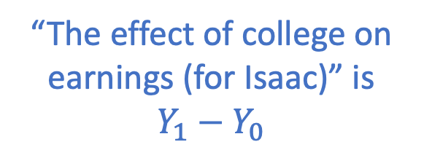


Last time...
What do we mean by “X causes Y?”
Difficult question
Lots of answers
One answer: Manipulation-based approaches
Example: What is the effect of college on earnings?
Earnings: $Y_{0}$
Earnings: $Y_{1}$
“The effect of college on earnings (for Isaac)” is $Y_{1}−Y_{0}$
College-Abstaining Isaac
College-Going Isaac

Slide 5
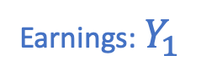
Last time...
What do we mean by “X causes Y?”
Difficult question
Lots of answers
One answer: Manipulation-based approaches
Example: What is the effect of college on earnings?
Practical issues:
We can never observe both outcomes for a single individual
Earnings: ???
Earnings: $Y_{1}$
College-Abstaining Isaac
College-Going Isaac

Slide 6
Last time...
What do we mean by “X causes Y?”
Difficult question
Lots of answers
One answer: Manipulation-based approaches
Example: What is the effect of college on earnings?
Practical issues:
We can never observe both outcomes for a single individual
This is “The fundamental problem of causal inference”
We can look at a population instead of an individual...but then we worried about confounding variables.

Slide 7
Today
A closer look at causal inference in the “manipulation-based” sense.
More notation! Yay!
This will motivate/formalize why randomized control trials (RCTs) can help establish causality.
It will also motivate what we should do when we can’t do an RCT.

Slide 8
Observational Comparison vs Average Treatment Effect
What we observe from (observational) data
What we actually want to measure

Slide 9
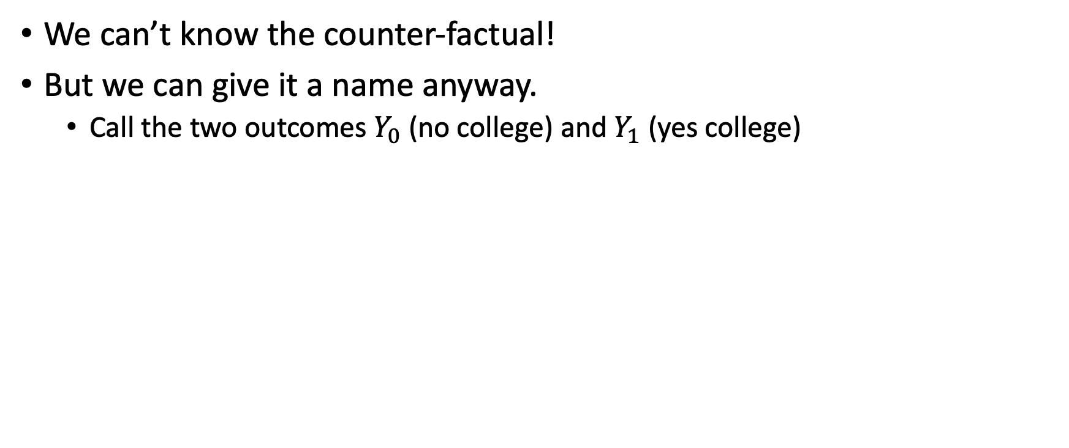

Fundamental problem of causal inference
We can’t know the counter-factual!
But we can give it a name anyway.
Call the two outcomes $Y_{0}$ (no college) and $Y_{1}$ (yes college)
Earnings: ???
Earnings: $Y_{1}$
College-Abstaining Isaac
College-Going Isaac

Slide 10

Fundamental problem of causal inference
We can’t know the counter-factual!
But we can give it a name anyway.
Call the two outcomes $Y_{0}$ (no college) and $Y_{1}$ (yes college)
Earnings: $Y_{0}$
Earnings: $Y_{1}$
College-Abstaining Isaac
College-Going Isaac

Slide 11

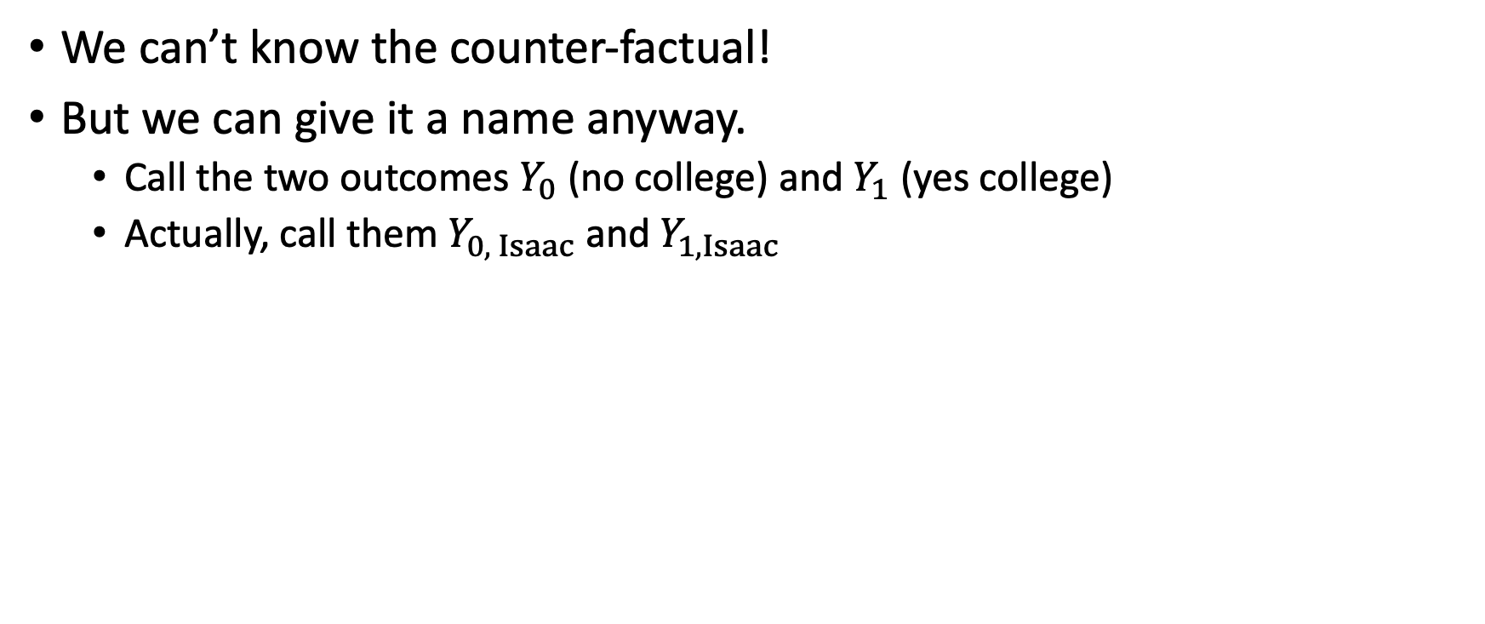

Fundamental problem of causal inference
We can’t know the counter-factual!
But we can give it a name anyway.
Call the two outcomes $Y_{0}$ (no college) and $Y_{1}$ (yes college)
Actually, call them $Y_{0, Isaac}$ and $Y_{1, Isaac}$
Earnings: $Y_{0, Isaac}$
Earnings: $Y_{1, Isaac}$
College-Abstaining Isaac
College-Going Isaac

Slide 12
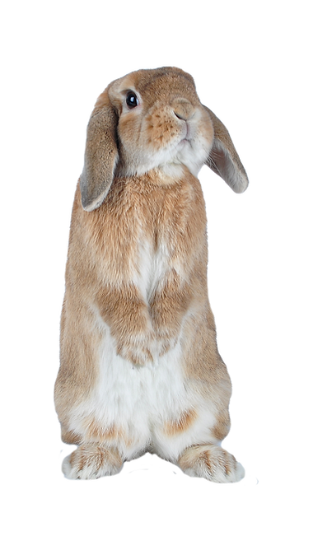
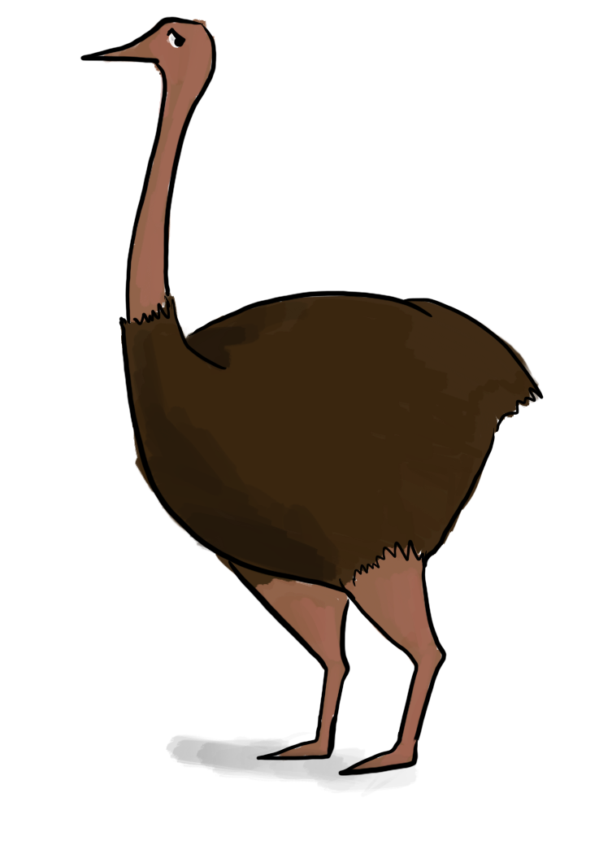



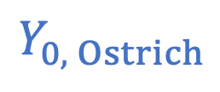
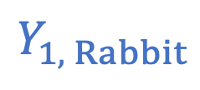
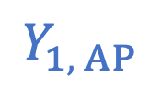
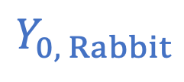
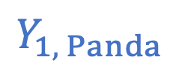
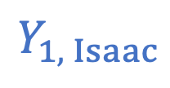
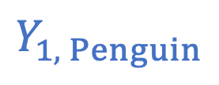
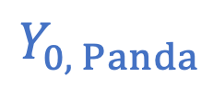
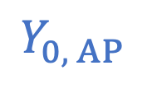
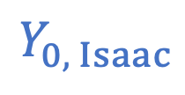
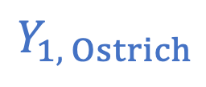
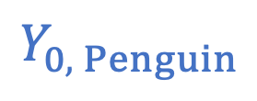
Attempt to deal with the Fundamental Problem of Causal Inference Look at a larger population!
Isaac
Panda
Rabbit
Ostrich
Penguin
Alien Penguin
$$Y_{0, Isaac}$$
$$Y_{0, Panda}$$
$$Y_{0, Rabbit}$$
$$Y_{0, Ostrich}$$
$$Y_{0, Penguin}$$
$$Y_{0, AP}$$
????
????
????
$10
$5
$6
$$Y_{1, Isaac}$$
$$Y_{1, Panda}$$
$$Y_{1, Rabbit}$$
$$Y_{1, Ostrich}$$
$$Y_{1, Penguin}$$
$$Y_{1, AP}$$
$10
$15
$11
????
????
????

Slide 13
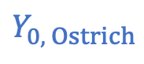
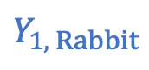
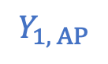
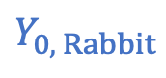
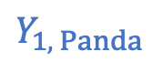
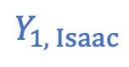
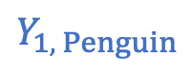
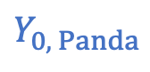
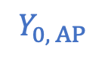
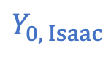
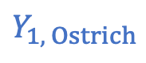
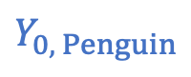
Attempt to deal with the Fundamental Problem of Causal Inference Look at a larger population!
Discuss: Given this data, what is your best estimate of “The effect of college on earnings”? What are some issues with this estimate?
Isaac
Panda
Rabbit
Ostrich
Penguin
Alien Penguin
$$Y_{0, Isaac}$$
$$Y_{0, Panda}$$
$$Y_{0, Rabbit}$$
$$Y_{0, Ostrich}$$
$$Y_{0, Penguin}$$
$$Y_{0, AP}$$
????
????
????
$10
$5
$6
$$Y_{1, Isaac}$$
$$Y_{1, Panda}$$
$$Y_{1, Rabbit}$$
$$Y_{1, Ostrich}$$
$$Y_{1, Penguin}$$
$$Y_{1, AP}$$
$10
$15
$11
????
????
????

Slide 14
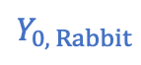
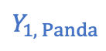
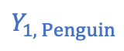
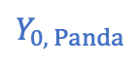
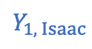
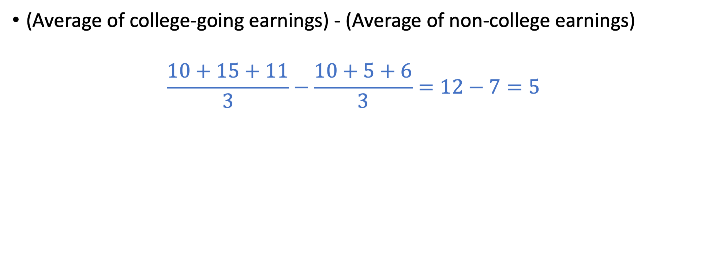
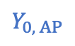
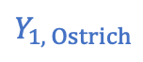
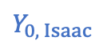
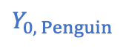
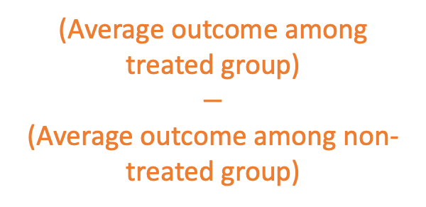
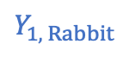
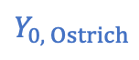

Observational Comparison
(Average of college-going earnings) - (Average of non-college earnings)
$$\frac{10+15+11}{3}−\frac{10+5+6}{3}=12−7=5$$
Definition:
Observational comparison of a treatment:
Isaac
Panda
Rabbit
Ostrich
Penguin
Alien Penguin
$$Y_{0, Isaac}$$
$$Y_{0, Panda}$$
$$Y_{0, Rabbit}$$
$$Y_{0, Ostrich}$$
$$Y_{0, Penguin}$$
$$Y_{0, AP}$$
(Average outcome among treated group)
$$−$$
(Average outcome among non-treated group)
????
????
????
$10
$5
$6
$$Y_{1, Isaac}$$
$$Y_{1, Panda}$$
$$Y_{1, Rabbit}$$
$$Y_{1, Ostrich}$$
$$Y_{1, Penguin}$$
$$Y_{1, AP}$$
$10
$15
$11
????
????
????

Slide 15
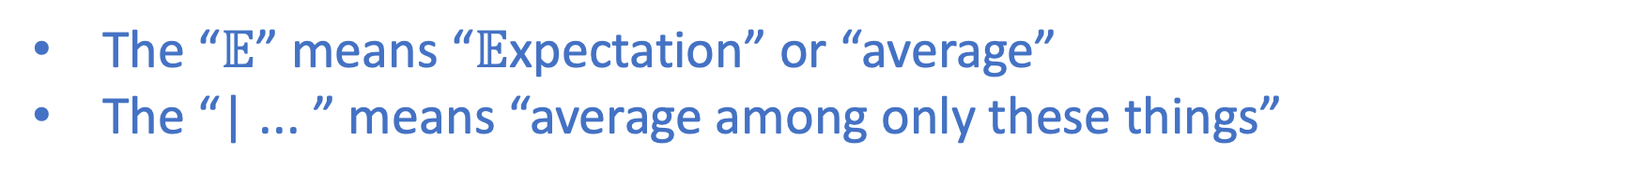
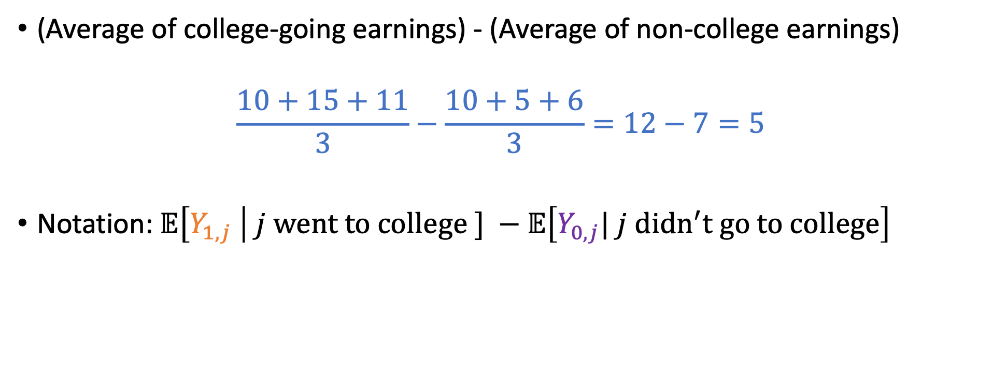
Observational Comparison
(Average of college-going earnings) - (Average of non-college earnings)
$$\frac{10+15+11}{3}−\frac{10+5+6}{3}=12−7=5$$
Notation:$𝔼\left[Y_{1,j} \right| j went to college ] −𝔼\left[Y_{0,j}| j didn^{′}t go to college\right]$
Earnings if person j went to college
Earnings if person j didn’t go to college
The “$𝔼$” means “$𝔼$xpectation” or “average”
The “| ... ” means “average among only these things”

Slide 16
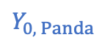
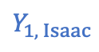
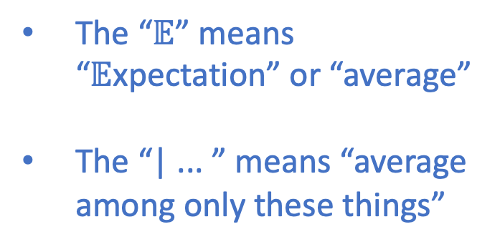
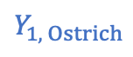

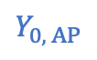








Observational Comparison
Notation:$𝔼\left[Y_{1,j} \right| j went to college ] −𝔼\left[Y_{0,j}| j didn^{′}t go to college\right]$
Earnings if person j went to college
Earnings if person j didn’t go to college
The “$𝔼$” means “$𝔼$xpectation” or “average”
The “| ... ” means “average among only these things”
Isaac
Panda
Rabbit
Ostrich
Penguin
Alien Penguin
$$Y_{0, Isaac}$$
$$Y_{0, Panda}$$
$$Y_{0, Rabbit}$$
$$Y_{0, Ostrich}$$
$$Y_{0, Penguin}$$
$$Y_{0, AP}$$
????
????
????
$10
$5
$6
$$Y_{1, Isaac}$$
$$Y_{1, Panda}$$
$$Y_{1, Rabbit}$$
$$Y_{1, Ostrich}$$
$$Y_{1, Penguin}$$
$$Y_{1, AP}$$
$10
$15
$11
????
????
????

Slide 17












Issues with Observational Comparison
“Selection effects” or “Confounding Variables”: Maybe folks who choose to go to college are “different” from folks who don’t.
E.g., in this example, they are all mammals, vs. birds.
(In real life, maybe they have higher socio-economic status)
Maybe mammals in general make more/less money than birds.
Maybe mammals in general get more/less out of college than birds.
Isaac
Panda
Rabbit
Ostrich
Penguin
Alien Penguin
$$Y_{0, Isaac}$$
$$Y_{0, Panda}$$
$$Y_{0, Rabbit}$$
$$Y_{0, Ostrich}$$
$$Y_{0, Penguin}$$
$$Y_{0, AP}$$
????
????
????
$10
$5
$6
$$Y_{1, Isaac}$$
$$Y_{1, Panda}$$
$$Y_{1, Rabbit}$$
$$Y_{1, Ostrich}$$
$$Y_{1, Penguin}$$
$$Y_{1, AP}$$
$10
$15
$11
????
????
????

Slide 18












Let’s think about this with notation! Yay notation!
What we just computed:
What we wanted to compute:
$$𝔼\left[Y_{1,j} \right| j went to college ] −𝔼\left[Y_{0,j}| j didn^{′}t go to college\right]$$
$$𝔼\left[Y_{1,j}\right]−𝔼\left[Y_{0,j}\right]=𝔼[Y_{1,j} −Y_{0,j}]$$
Isaac
Panda
Rabbit
Ostrich
Penguin
Alien Penguin
$$Y_{0, Isaac}$$
$$Y_{0, Panda}$$
$$Y_{0, Rabbit}$$
$$Y_{0, Ostrich}$$
$$Y_{0, Penguin}$$
$$Y_{0, AP}$$
????
????
????
$10
$5
$6
$$Y_{1, Isaac}$$
$$Y_{1, Panda}$$
$$Y_{1, Rabbit}$$
$$Y_{1, Ostrich}$$
$$Y_{1, Penguin}$$
$$Y_{1, AP}$$
$10
$15
$11
????
????
????

Slide 19
Let’s think about this with notation! Yay notation!
What we just computed:
What we wanted to compute:
$$𝔼\left[Y_{1,j} \right| j went to college ] −𝔼\left[Y_{0,j}| j didn^{′}t go to college\right]$$
This is called the Average Treatment Effect (ATE).
It is the effect of college on earnings on the average person in the population.
$$𝔼\left[Y_{1,j}\right]−𝔼\left[Y_{0,j}\right]=𝔼[Y_{1,j} −Y_{0,j}]$$
Isaac
Panda
Rabbit
Ostrich
Penguin
Alien Penguin
$$Y_{0, Isaac}$$
$$Y_{0, Panda}$$
$$Y_{0, Rabbit}$$
$$Y_{0, Ostrich}$$
$$Y_{0, Penguin}$$
$$Y_{0, AP}$$
????
????
????
$10
$5
$6
We can’t compute ATE on the whole population, since we don’t know the ???? values.
$$Y_{1, Isaac}$$
$$Y_{1, Panda}$$
$$Y_{1, Rabbit}$$
$$Y_{1, Ostrich}$$
$$Y_{1, Penguin}$$
$$Y_{1, AP}$$
$10
$15
$11
????
????
????

Slide 20
Observational comparison vs. ATE
Observational comparison:
$$𝔼\left[Y_{1,j} \right| j went to college ] −𝔼\left[Y_{0,j}| j didn^{′}t go to college\right]$$

Slide 21

Observational comparison vs. ATE
Observational comparison:
$$𝔼\left[Y_{1,j} \right| j college ] −𝔼\left[Y_{0,j}| j no college\right]$$
$$=𝔼\left[Y_{1,j} \right| j college ] −𝔼\left[Y_{0,j} \right| j college ]$$
$$+ 𝔼\left[Y_{0,j} \right| j college ] − 𝔼\left[Y_{0,j}| j no college\right]$$
We will interpret each of these two terms:
$𝔼\left[Y_{1,j} \right| j college ] −𝔼\left[Y_{0,j} \right| j college ]$
$𝔼\left[Y_{0,j} \right| j college ] −𝔼\left[Y_{0,j}| j no college\right]$

Slide 22














Observational comparison vs. ATE ctd.
$$𝔼\left[Y_{1,j} \right| j college ] −𝔼\left[Y_{0,j} \right| j college ]$$
$$𝔼\left[Y_{0,j} \right| j college ] −𝔼\left[Y_{0,j}| j no college\right]$$
Observational comparison=
$$+$$
First term:
Discuss: how should we interpret this?
How does it compare to the ATE?
$$−$$
Isaac
Panda
Rabbit
Ostrich
Penguin
Alien Penguin
$$Y_{0, Isaac}$$
$$Y_{0, Panda}$$
$$Y_{0, Rabbit}$$
$$Y_{0, Ostrich}$$
$$Y_{0, Penguin}$$
$$Y_{0, AP}$$
????
????
????
$10
$5
$6
$$Y_{1, Isaac}$$
$$Y_{1, Panda}$$
$$Y_{1, Rabbit}$$
$$Y_{1, Ostrich}$$
$$Y_{1, Penguin}$$
$$Y_{1, AP}$$
$10
$15
$11
????
????
????

Slide 23
Observational comparison vs. ATE ctd.
$$𝔼\left[Y_{1,j} \right| j college ] −𝔼\left[Y_{0,j} \right| j college ]$$
$$𝔼\left[Y_{0,j} \right| j college ] −𝔼\left[Y_{0,j}| j no college\right]$$
Observational comparison=
$$+$$
First term:
$$−$$
Isaac
Panda
Rabbit
Ostrich
Penguin
Alien Penguin
This is the effect of going to college on the population who chooses to go to college.
It is close to the ATE, but might be different if there is selection on treatment.
$$Y_{0, Isaac}$$
$$Y_{0, Panda}$$
$$Y_{0, Rabbit}$$
$$Y_{0, Ostrich}$$
$$Y_{0, Penguin}$$
$$Y_{0, AP}$$
????
????
????
$10
$5
$6
$$Y_{1, Isaac}$$
$$Y_{1, Panda}$$
$$Y_{1, Rabbit}$$
$$Y_{1, Ostrich}$$
$$Y_{1, Penguin}$$
$$Y_{1, AP}$$
$10
$15
$11
????
????
????

Slide 24
Selection on Treatment
Those who receive treatment are (on average) affected differently by the treatment than those who don’t.
In this example, maybe mammals get more out of college than birds.
Our first term: the effect of going to college on the population who chooses to go to college.
If there is selection on treatment, we can’t extrapolate from that to the effect of college on the whole population (aka ATE).

Slide 25
Observational comparison vs. ATE ctd.
$$𝔼\left[Y_{1,j} \right| j college ] −𝔼\left[Y_{0,j} \right| j college ]$$
$$𝔼\left[Y_{0,j} \right| j college ] −𝔼\left[Y_{0,j}| j no college\right]$$
Observational comparison=
$$+$$
First term:
$$−$$
Isaac
Panda
Rabbit
Ostrich
Penguin
Alien Penguin
This is the effect of going to college on the population who chooses to go to college.
It is close to the ATE, but might be different if there is selection on treatment.
$$Y_{0, Isaac}$$
$$Y_{0, Panda}$$
$$Y_{0, Rabbit}$$
$$Y_{0, Ostrich}$$
$$Y_{0, Penguin}$$
$$Y_{0, AP}$$
????
????
????
$10
$5
$6
$$Y_{1, Isaac}$$
$$Y_{1, Panda}$$
$$Y_{1, Rabbit}$$
$$Y_{1, Ostrich}$$
$$Y_{1, Penguin}$$
$$Y_{1, AP}$$
$10
$15
$11
????
????
????

Slide 26
Observational comparison vs. ATE ctd.
$$𝔼\left[Y_{1,j} \right| j college ] −𝔼\left[Y_{0,j} \right| j college ]$$
$$𝔼\left[Y_{0,j} \right| j college ] −𝔼\left[Y_{0,j}| j no college\right]$$
Observational comparison=
$$+$$
Second term:
Discuss: how should we interpret this?
$$−$$
Isaac
Panda
Rabbit
Ostrich
Penguin
Alien Penguin
$$Y_{0, Isaac}$$
$$Y_{0, Panda}$$
$$Y_{0, Rabbit}$$
$$Y_{0, Ostrich}$$
$$Y_{0, Penguin}$$
$$Y_{0, AP}$$
????
????
????
$10
$5
$6
$$Y_{1, Isaac}$$
$$Y_{1, Panda}$$
$$Y_{1, Rabbit}$$
$$Y_{1, Ostrich}$$
$$Y_{1, Penguin}$$
$$Y_{1, AP}$$
$10
$15
$11
????
????
????

Slide 27
Observational comparison vs. ATE ctd.
$$𝔼\left[Y_{1,j} \right| j college ] −𝔼\left[Y_{0,j} \right| j college ]$$
$$𝔼\left[Y_{0,j} \right| j college ] −𝔼\left[Y_{0,j}| j no college\right]$$
Observational comparison=
$$+$$
Second term:
$$−$$
Isaac
Panda
Rabbit
Ostrich
Penguin
Alien Penguin
This is the difference in earnings between the two populations, if no one had gone to college.
If it is non-zero, there is selection on levels.*
$$Y_{0, Isaac}$$
$$Y_{0, Panda}$$
$$Y_{0, Rabbit}$$
$$Y_{0, Ostrich}$$
$$Y_{0, Penguin}$$
$$Y_{0, AP}$$
????
????
????
$10
$5
$6
$$Y_{1, Isaac}$$
$$Y_{1, Panda}$$
$$Y_{1, Rabbit}$$
$$Y_{1, Ostrich}$$
$$Y_{1, Penguin}$$
$$Y_{1, AP}$$
$10
$15
$11
????
????
????
*As in “baseline level of earnings”

Slide 28
Selection on Levels
Those who receive the treatment would have had different outcomes than those who don’t, even if no one got the treatment.
In this example, maybe mammals would make more money than birds, even if no one went to college.
Our second term: the difference in earnings between the two populations, if no one had gone to college.
If there is selection on levels, then this is non-zero.

Slide 29
Observational comparison vs. ATE ctd.
$$𝔼\left[Y_{1,j} \right| j college ] −𝔼\left[Y_{0,j} \right| j college ]$$
$$𝔼\left[Y_{0,j} \right| j college ] −𝔼\left[Y_{0,j}| j no college\right]$$
Observational comparison=
$$+$$
Second term:
$$−$$
Isaac
Panda
Rabbit
Ostrich
Penguin
Alien Penguin
This is the difference in earnings between the two populations, if no one had gone to college.
If it is non-zero, there is selection on levels.*
$$Y_{0, Isaac}$$
$$Y_{0, Panda}$$
$$Y_{0, Rabbit}$$
$$Y_{0, Ostrich}$$
$$Y_{0, Penguin}$$
$$Y_{0, AP}$$
????
????
????
$10
$5
$6
$$Y_{1, Isaac}$$
$$Y_{1, Panda}$$
$$Y_{1, Rabbit}$$
$$Y_{1, Ostrich}$$
$$Y_{1, Penguin}$$
$$Y_{1, AP}$$
$10
$15
$11
????
????
????
*As in “baseline level of earnings”

Slide 30



Observational comparison vs. ATE ctd.
$$𝔼\left[Y_{1,j} \right| j college ] −𝔼\left[Y_{0,j} \right| j college ]$$
$$𝔼\left[Y_{0,j} \right| j college ] −𝔼\left[Y_{0,j}| j no college\right]$$
Observational comparison=
$$+$$
Observational comparison =
The effect of going to college on the population who chooses to go to college.
$=$ ATE + effect of “Selection on Treatment”
$$+$$
The difference in earnings between college-goers and non-college goers if no one had gone to college.
$=$ effect of “Selection on Levels”

Slide 31

Observational comparison vs. ATE ctd.
Observational comparison =
The effect of going to college on the population who chooses to go to college.
$=$ ATE + effect of “Selection on Treatment”
$$+$$
The difference in earnings between college-goers and non-college goers if no one had gone to college.
$=$ effect of “Selection on Levels”
Take-away: If there is neither “selection on treatment” nor “selection on levels” then Observational Comparison = ATE = what we wanted.

Slide 32
Quick recap so far
We want to know the effect of college on earnings (say).
We have observational data, and can make an observational comparison.
(Average earnings among college-goers) – (Average earnings among non-college goers)
What we really want is the Average Treatment Effect (ATE):
(Average earnings among everyone if they did go to college)
- (Average earnings among everyone if they did not go to college)
Mathematically, there are two reasons these might be different:
Selection on treatment: The folks who choose to go to college are affected by college differently than those who don’t.
Selection on levels: The folks who choose to go to college have a different baseline level than those who don’t.

Slide 33
Aside: do you think these are important? (For returns to college in particular?)
Selection on treatment: The folks who choose to go to college are affected by college differently than those who don’t.
Selection on levels: The folks who choose to go to college have a different baseline level than those who don’t.
Discuss! (We’ll come back to this later with some data...)

Slide 34
Exercise: Practice with new notation/defs!
Suppose you want to know the effect of get-out-the-vote drives on voter turnout.
Thanks for the encouragement/information/help! I sure will go vote now!
Hi! Voting is important! Election day is Tuesday. Do you want some help registering to vote?
Um, thanks for the effort, but obviously I am/am not going to vote no matter what.
Don’t tell me what to do! I was going to vote, but now you’ve made me so angry that I’ll stay home. ☹

Slide 35

Exercise Practice with new notation/defs!
Suppose you want to know the effect of get-out-the-vote drives on voter turnout.
Data looks like:
Define:
$Y_{1,j}=$ voter turnout if j had a voter drive
$Y_{0,j}=$voter turnout if j did not have a drive
Interpret the following in words/jargon:
$𝔼\left[Y_{1,j} | j had drive \right] −𝔼\left[Y_{0,j} | j had no drive \right]$
$𝔼\left[Y_{1,j} | j had drive \right] −𝔼\left[Y_{0,j} | j had drive \right]$
Write math expressions for:
The Average Treatment Effect (ATE)
The effect of Selection on Levels
District | Was there a get-out-the-vote drive? | Voter Turnout
Çatalca | Yes | 89.8%
Silivri | Yes | 90.7%
Arnavutköy | No | 86.8%
Büyükçekmece | Yes | 87.6%
Beylikdüzü | No | 87.6%
Şile | No | 90.2%
... | ... | ...
Voter turnout from May 14, 2023 Turkish presidential election, from yenisafak.com
Get-out-the-vote drive data is made up for this example.
No need to crunch any numbers!

Slide 36

Voter Turnout Example
$Y_{1,j}=$ voter turnout if j had a get-out-the-vote drive
$Y_{0,j}=$voter turnout if j did not have a get-out-the-vote drive
$𝔼\left[Y_{1,j} | j had drive \right] −𝔼\left[Y_{0,j} | j had no drive \right]$
This is the observational comparison!
Districts
A. B. C. D. E. F. G. H.
Drive
? ? ? ? 85% 90% 75% 80%
No Drive
82% 86% 78% 73% ? ? ? ?

Slide 37

Voter Turnout Example
$Y_{1,j}=$ voter turnout if j had a get-out-the-vote drive
$Y_{0,j}=$voter turnout if j did not have a get-out-the-vote drive
$𝔼\left[Y_{1,j} | j had drive \right] −𝔼\left[Y_{0,j} | j had drive \right]$
This is the effect of a get-out-the-vote drive on those districts in which there was a get-out-the-vote drive.
Districts
It would be equal to the ATE if there weren’t any selection on treatment.
A. B. C. D. E. F. G. H.
Drive
? ? ? ? 85% 90% 75% 80%
No Drive
82% 86% 78% 73% ? ? ? ?

Slide 38

Voter Turnout Example
$Y_{1,j}=$ voter turnout if j had a get-out-the-vote drive
$Y_{0,j}=$voter turnout if j did not have a get-out-the-vote drive
Math for: The Average Treatment Effect (ATE)
$𝔼\left[Y_{1,j} \right] −𝔼\left[Y_{0,j}\right]$ = $𝔼\left[Y_{1,j}−Y_{0,j}\right]$
Districts
A. B. C. D. E. F. G. H.
Drive
? ? ? ? 85% 90% 75% 80%
No Drive
82% 86% 78% 73% ? ? ? ?

Slide 39


Voter Turnout Example
$Y_{1,j}=$ voter turnout if j had a get-out-the-vote drive
$Y_{0,j}=$voter turnout if j did not have a get-out-the-vote drive
Math for: The effect of selection on levels
$$𝔼\left[Y_{0,j} | j had drive \right] −𝔼\left[Y_{0,j} | j had no drive \right]$$
This is the difference in voter turnout between the two groups, if there were no get-out-the-vote drives anywhere.
Districts
A. B. C. D. E. F. G. H.
Drive
? ? ? ? 85% 90% 75% 80%
No Drive
82% 86% 78% 73% ? ? ? ?

Slide 40
Quick recap so far
We want to know the effect of college on earnings (say).
We have observational data, and can make an observational comparison.
What we really want is the Average Treatment Effect (ATE)
Mathematically, there are two reasons these might be different:
Selection on treatment: Those who select into the treatment might be affected by it differently than those who don’t.
Selection on levels: Those who select into the treatment might have different baseline levels than those who don’t.

Slide 41
So the question is...
When is Average Treatment Effect = Observational Comparison?
Aka, when do we not need to worry about either selection on treatment or selection on levels?
If you got to decide who got the treatment, and you wanted to estimate ATE, what would you do?
Suppose your only goal is to estimate ATE...
not to educate people or increase voter turnout, or behave ethically or...

Slide 42
The Magic of RCTs

Slide 43
Randomized Control Trials (RCTs)
Decide who gets the “treatment” randomly.
“Treatment” = “Goes to College” or “Gets a Voting Drive” or ...
Why is this good?
There’s no systematic pattern about who gets the treatment, so:
There is no effect of Selection on Treatment
There is no effect of Selection on Levels
Therefore, ATE = Observational Effect! Hooray!

Slide 44
Aside: Confounding Variables
We just said that RCTs are good because:
No selection on treatment
No selection on levels
Last time, we were worried about confounding variables.
Going to college
Discuss:
What’s the relationship between “confounding variables” and “selection”?
In the language of “confounding variables”, why do RCTs help?
Socio-Economic Status
Income at age 30

Slide 45
What’s the relationship?
Confounding variables: A third variable might influence both college-going and earnings.
This could be either selection on treatment or on levels. For example:
Folks from wealthier backgrounds might be more likely to go to college (they can afford it) and also more likely to make more money later (they have family connections that help).
Folks from wealthier backgrounds might go to better high-schools, and are better prepared to get more out of college; so they may attend college at higher rates.
Selection on Levels
Selection on Treatment

Slide 46
What’s the relationship?
Confounding variables: A third variable might influence both college-going and earnings.
This could be either selection on treatment or on levels.
The “selection on treatment/levels” language is more detailed than the “confounding variables” language.

Slide 47
Another take on the magic of RCTs
There’s no systematic pattern about who gets the treatment, so:
The treatment and control groups are (probably) approximately split on all possible confounding variables.
Note that it doesn’t matter whether we have thought of all of the variables! We are robust to not knowing the true model of the world!
It also doesn’t matter whether we can observe all of the variables!
High SES vs. Low SES?
Mammal vs. Bird?
Flightless vs. Flying?
Interested in Formula 1 vs. not interested in Formula 1?

Slide 48
End Aside
Take-away: RCTs are good because:
No systematic pattern about who gets the treatment, so:
No effect of selection on treatment
No effect of selection on levels
-or-
Every possible confounding variable (even the unobserved ones that we hadn’t thought of!) gets split about equally between treatment and control

Slide 49
Problem solved! Run everything as an RCT!
Sometimes this works.
People do run RCTs about the efficacy of get-out-the-vote drives.
But sometimes this is not possible/ethical.
You can’t tell someone to go to college or not at random.
What can we do?
Think about it in groups, for the returns-to-college example.

Slide 50
When we can’t do an RCT...
Sometimes we can randomize something
E.g., we can randomize who gets information about financial aid.
Assuming that getting more information can affect whether or not you go to college*, maybe this gives a bit of randomness about who goes to college and who doesn’t.
We can look for natural experiments
Maybe you are more likely to attend a college if the weather is nice on the day you visit it.
We think that the weather is pretty random...
We can look for discontinuities
Say you get into University X if your test score is at least Y.
Whether you get test score Y or Y-1 seems pretty random...
We’ll talk a lot more about these two in the next two classes
*More on this in a moment...

Slide 51
A few caveats about RCTs

Slide 52
Caveat(s)...
Suppose I really did randomize who went to college, between two people:
The observational comparison is $12 - $10 = $2.
Since I randomized, no selection on treatment or selection on levels
Thus, the average treatment effect of college is $2 of salary.
I conclude that if anyone on earth is deciding between going to college or not, they should expect that college will gain them $2.
Issues with this conclusion?
$10
$12
Panda
Rabbit

Slide 53


Caveat 0: Everyone’s different!
The $2 statistic is just an average. It might be that no one will have a $2 gain from college.
If you have reason to believe you’ll get more or less out of college than the “average” person, your expected returns to college may be different.
-1
+5
-1
+5
-1
-1
+5
-1
+5
+5
+5
-1
My slow and steady personality is optimally suited for studying hard and getting lots out of school!
+$1000

Slide 54

Caveat 1: Sample Size
I only have two data points.
The statements we are making are about averages:
(Average) Observational Effect = Average Treatment Effect
$𝔼\left[Y_{1,j} | j treated \right] −𝔼\left[Y_{0,j} | j not treated \right]=𝔼$[ $Y_{1,j }−Y_{0,j} ]$
If we want to estimate an average accurately, we need a lot of samples.
E.g., what is the average height of students at Koç?
Choose one random student and look at their height
Choose 1000 random students and look at their average height
Similarly, if we want to make inferences from an RCT, we need a lot of test subjects, the more the better.
Obviously better

Slide 55

Caveat 2: What’s the population?
I was extrapolating from these two test subjects to anyone in the world.
Sample sizes aside, maybe I didn’t pick my test subjects from the same distribution as “everyone in the world”
Maybe I picked people who agreed to participate in the experiment
There was “selection into the experiment”
Maybe I picked people who live in a particular country, or of a particular age, or...
Maybe I picked a representative sample, but then some people dropped out.
RCTs tell us only about the population that our test subjects came from.
vs

Slide 56
Caveat 3: Interference/spillovers
I assumed that what happens to the treatment group doesn’t affect the control group.
In this example: whether or not Panda goes to college doesn’t affect Rabbit.
In jargon: “Stable Unit Treatment Value Assumption” (SUTVA)
But suppose I run a very large RCT to encourage people to go to college.
Significantly more people go to college
Supply and Demand: more college-educated labor supply means lower wages
If everyone were to go to college, the returns to college might be different than my sample-size-of-2 RCT!
This matters when we run “small” RCTs and then want to “scale up” the program.

Slide 57
Example RCT

Slide 58
When do people run RCTs?
RCTs are the “gold standard” of causal inference.
Assuming one is careful to get large, representative samples
Medical researchers, biologists, etc, use them all the time
The US Food and Drug Administarion requires RCTs before approving drugs.
Social scientists use them when possible
To evaluate policies
To understand how society/the economy/politics/etc works
Computer scientists sometimes use them too!
To evaluate new software/hardware/systems
To understand complex systems that cannot be understood analytically
(Etc...)
Notes:
Aside: Physicists, chemists, etc tend to think differently about experiments:
The goal is typically to refute/support a hypothesis, rather than measure a causal effect.
Experiments need not be randomized.
(Of course there are exceptions)

Slide 59
One example
Returns to education
Something education-related that may help us think about returns to education by looking at selection into college.

Slide 60
What can we say about returns to education? With an RCT?

Slide 61
Background Low-income students are less likely to attend college
“Low-income:” eligible for free or reduced-price lunch. (Household income of about $46K in 2018).
“High-achieving:” Plausible admit to U Michigan. (GPA > 3.3 and SAT > 1100.)
Discuss: Why?
Important: these students would be eligible for very generous financial aid at competitive colleges.
Context: The University of Michigan is a good big public school in the US. (Also Isaac and Mary’s alma mater. Go Blue!)

Slide 62
Aside: financial aid for students in Michigan
Take-away: It is cheaper to go to U of M (most selective) than to
Washtenaw CC (least selective) for low-income students!

Slide 63

Possible reasons low income students are less like to attend college
Selection on treatment: Low-income students perceive there to be lower returns to college for them.
That is, their $Y_{1}−Y_{0}$ is smaller
Lack of information: Even though these students would be eligible for financial aid, they don’t realize that.

Slide 64
To figure it out... They did an RCT!
Randomly send informative mailers to some* high-achieving, low-income students.
*Randomize at the level of high-school

Slide 65

Sanity-check! Did the random sampling split up observable variables?
Take-away here is that all these numbers are pretty close!

Slide 66

Sanity-check! Did the random sampling split up observable variables?
Control
Treatment
Take-away here is that all these numbers are pretty close!

Slide 67
The program is effective! (In getting this population of students to apply/be admitted to U of M)

Slide 68

Aside: More practice with notation!
In this RCT, what is $Y_{0}$? What is $Y_{1}$? What is $Y_{1}−Y_{0}$?
$Y_{0}$ = would you apply if you didn’t get the mailer?
$Y_{1}$ = would you apply if you did get the mailer?
$Y_{1}−Y_{0}$ = “average treatment effect” = .422 percentage points.
What does “Selection on levels” mean in this context?
There would be selection on levels if folks who got the mailer were more likely to be of the type to apply to U of M anyway.
What does “Selection on treatment” mean in this context?
There would be selection on treatment if folks who got the mailer were more likely to be the type who responds to mailers.
Are we worried about either?
Not really! It was random! (And as a sanity-check, all of the things we can observe looked pretty evenly split).

Slide 69
Back to effects of the program
Recall that high-achieving low-income students are less likely to attend college.
What about after the intervention?
Low-income students who got the mailer are more likely to attend selective schools than non-low-income students!

Slide 70
What about returns to college?
Selection on treatment: Students who choose to go to college are those who will get more out of it.
Selection on levels: Students who choose to go to college are those who would make a lot of money anyway.
Discuss:
Does the previous RCT change your mind about whether or not these are important effects?
Are there follow-up questions you’d like to ask?

Slide 71
What about returns to college?
Selection on treatment: Students who choose to go to college (without intervention) are those who will get more out of it.
This experiment shows that the reason many Michigan students don’t go to college is lack of information about cost, not an anticipation of getting less out of it.
This suggests that selection on treatment might not be as big a deal.
Selection on levels, and follow-up questions.
This study gives us a way to randomize who goes to college and who doesn’t!
Maybe we could use that as an RCT to study selection on levels?
Not enough time has passed – probably that paper will be written in 5-10 years!

Slide 72
Possible reasons low income students are less like to attend college
Remember this slide from before!
Selection on treatment: Low-income students perceive there to be lower returns to college for them.
That is, their $Y_{1}−Y_{0}$ is smaller
Lack of information: Even though these students would be eligible for financial aid, they don’t realize that.
If you give students more information, low income students are just as likely to attend selective colleges. So this suggests that selection on treatment isn’t a big concern (for this population of students).

Slide 73
Going forward...
We wanted an RCT for estimating the average treatment effect of college.
We can’t directly randomize who goes to college.
But we can randomize who gets a mailer, affecting who goes to college.
Natural question: How did the treatment students do later in life, vs. the control students?
They are planning on writing this paper in 5 or 10 years

Slide 74
Wrapping Up

Slide 75

Recap
A bunch of notation!
Average Treatment Affect = ${𝔼[Y}_{1}−Y_{0}]$
This might not be the observational effect because of:
Selection on treatment
Selection on levels
In an RCT, the ATE is the same as the observational effect!
But there are some caveats:
Need a big and representative sample
What happens if the experiment doesn’t change everyone’s behavior?
Next time!
(Note: the work we’ll talk about next time led to a recent Nobel prize in economics!)

Slide 76
Homework Assignment 2!
Available now on Blackboard!
Part 1: Look at data from an RCT
Part 2: Compare that to observational data. Can you replicate the RCT by trying to “condition” on characteristics that you think are relevant?

Slide 77
That’s all!
See you next week!

